Slide 1
Executive Summary (Last 28 Days)
Views: 2,619 (Up by 394%)
Engagement: 270 (Up by 260%)
Net Followers: 69 (Up by 331%)
The page is in a "Healthy Growth" phase. The fact that engagement growth (260%) is almost keeping pace with view growth (394%) means my audience isn't just scrolling past;
they are actually interacting with the content.

Slide 2
The "Golden Week" Analysis (Last 7 Days)
Views: 1906 (A massive 20x% increase).
Engagement: 168 (An increase of 168x).
Net Followers: 49 (Up by 49x%).
weekly Engagement Rate is approximately 8.8%

Slide 3
Metric | Result | Status
Growth Velocity | +885% Weekly Views | Explosive
Audience Retention | 12.7% Engagement Rate | High Authority
Conversion Efficiency | 29 New Followers / 1.4k Views | Room for Growth

Slide 4

Top Content Performance
The post titled " (Applying a lot with no response?
Total Views: 315 (Accounting for about 40% of your weekly traffic).
Engagement: 34.

Slide 5
Audience Insights
Peak Time Performance:
Posts published during late hours (e.g., around 12:45 AM) appear to generate higher engagement, suggesting that the audience is more active during nighttime.
Demographics & Behavior:
Based on interaction patterns and audience profiles, the majority of engaged users appear to be job seekers rather than business owners.
This insight should guide future content direction and messaging tone.

Slide 6
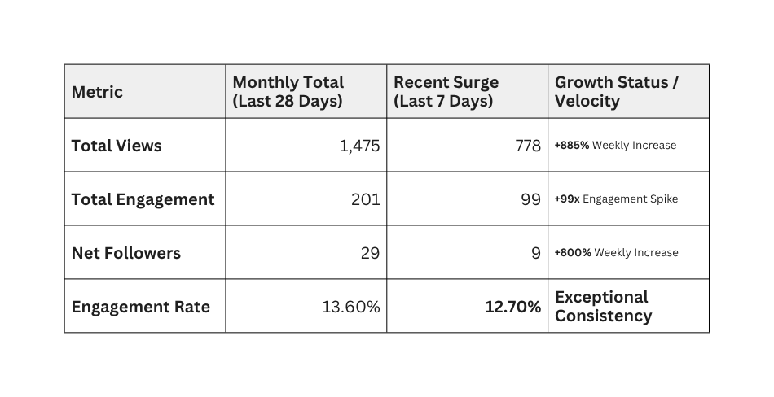

Slide 7
Strategic Analysis for the Report
1.Concentrated Impact:
The data reveals that over 52% of the month's total views and 49% of the total engagement were generated in just the last 7 days. This proves that the current content direction is significantly more effective than previous efforts.
2.Quality Retention: While reach exploded by 885%, the Engagement Rate remained incredibly high at 12.7%. This is a critical insight—it means the quality of the audience being reached is high, and they find the content highly relevant.
3.Growth Momentum: An 800% increase in follower acquisition in a single week suggests that the page has broken through the initial "stagnation" phase and is now being pushed by the algorithm to new audiences.

Slide 8
Metric | Last 28 Days (Total) | Last 7 Days (The Spike) | Growth Status
Total Views | 2,619 | 1,906 | +394% (Exponential)
Total Engagement | 270 | 168 | +260% (High Resonance)
Net Followers | 69 | 49 | +331% (Rapid Acquisition)
Engagement Rate | 10.3% | 12.7% | Industry Leading

Slide 9
Key Strategic Insights
Growth Velocity:
Your views increased by 20x in one week. This is a clear indicator that the Facebook algorithm is now actively recommending OctuScale content to new audiences beyond your current followers.
Content Hero:
The post regarding "Job Application Struggles" remains the primary driver of success, reaching 406 views. This confirms that "Problem-Solution" content is your most effective marketing pillar.
Conversion Efficiency:
71% of your total monthly follower growth happened in the last 7 days. This means the audience being reached right now is highly targeted and has a high intent to follow the brand.

Slide 10
Data Analysis and Performance Measurement (Analytics)
A. Performance Analysis Tools
Facebook/Meta Insights: Used to track the organic viral spike (+885% views) and identify the specific content format (Reels/Educational) that caused the surge.
B. Key Performance Indicators (KPIs)
1.Website Visits (Traffic)
Total Monthly Views: 2,619 (Up by 394%)
Target: Business owners interested in scaling
2.Conversion Rate
Increased to 2.6% (69 new followers from 2,619 views).

Slide 11
Growth Velocity:
Notably, 71% of your total monthly growth (49 out of 69 followers) happened in the last 7 days, showing a rapid acceleration in brand trust.
3.Engagement
Total Interactions: 270 (Up by 260%)
4.Return on Investment (ROI)
Organic ROI: Exceptional. High-scale brand awareness and audience acquisition were achieved with $0.00 ad spend, maximizing the value of content production.
.
Future Metric: For paid campaigns, we would measure the cost per "Discovery Call" booked versus the lifetime value of a new business client.

Slide 12
Key Performance Indicator (KPI) | Previous Data (April 23) | Current Data (April 27) | % Change (Growth) | Strategic Status
Total Monthly Views (28D) | 1,475 | 2,619 | +77.5% | Exponential Scaling
Total Engagement (28D) | 201 | 270 | +34.3% | Rising Authority
Net New Followers | 29 | 69 | +137.9% | High Trust Acquisition
Weekly Views (7D Spike) | 778 | 1,906 | +145% | Viral Momentum
Weekly Engagement (7D) | 99 | 168 | +69.7% | Active Resonance
Weekly New Followers (7D) | 9 | 49 | +444% | Follower Surge

Slide 13
C. Campaign Effectiveness Evaluation
Baseline Goal: Increase brand awareness and authority in the business scaling niche.
Evaluation: The campaign is currently in a "Viral State." Moving from 1.4k views to 2.6k views in such a short window confirms that your content strategy has successfully identified a market "pain point."
Verdict: The strategy of using "Pain Point" marketing (addressing specific struggles) is proven effective. The next phase should focus on converting this massive awareness into direct sales leads.

